Slide 1
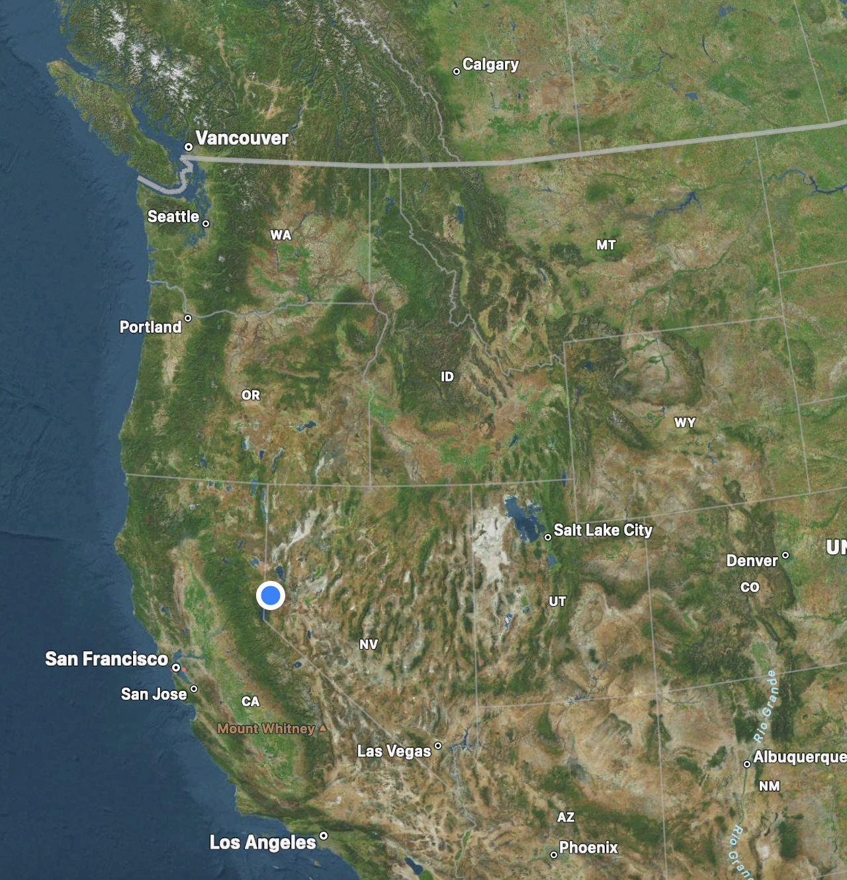
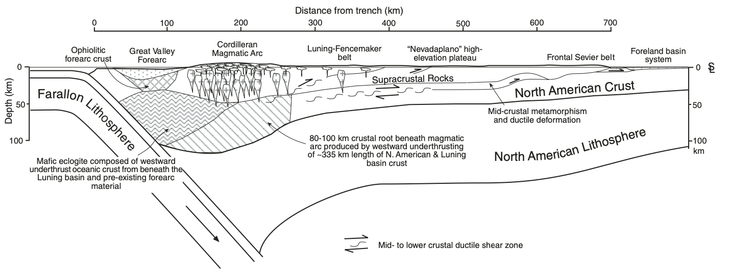
Regional Structure and Kinematic History of the Sevier Fold-and-Thrust Belt, Central Utah
DeCelles & Coogan, 2006
GEOL 730
Yair Franco
Notes:
Synthesize studies on tectonic and kinematic history of Sevier Thrust

Slide 2
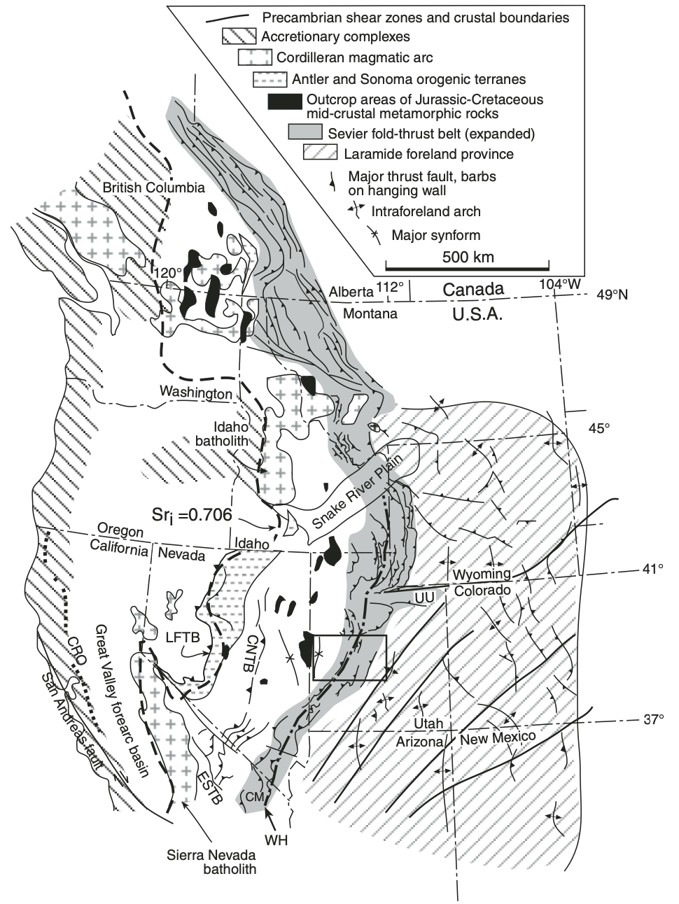
Sevier Fold-and-Thrust
Front of Cordilleran thrust belt
Accommodated compressive motion during Sevier Orogeny

Slide 3
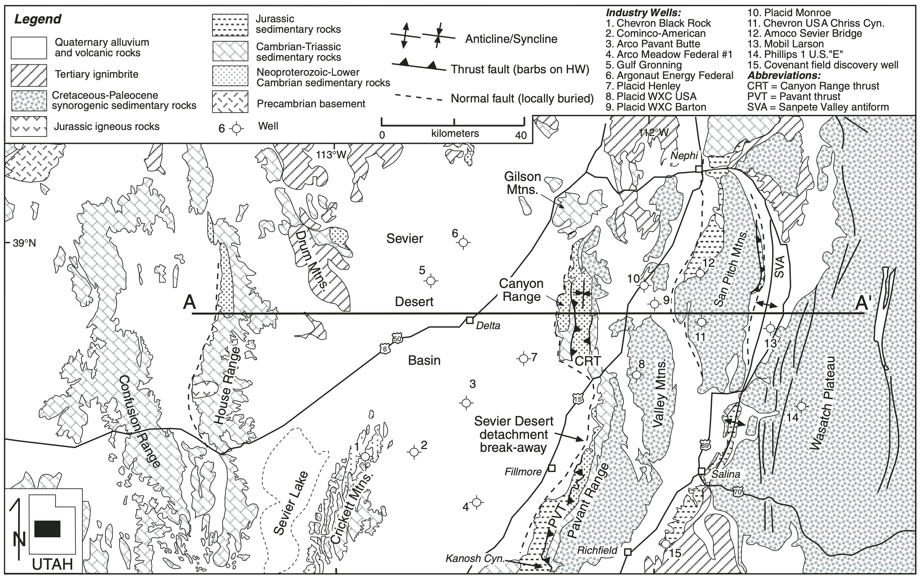
Notes:
Important units are sedimentary
In Central Utah, Sevier consists of
Canyon Range
Pavant
Paxton (buried)
Gunnison (buried)
Thrust systems

Slide 4
Stratigraphy
Low angle reflection interpreted as detachment
(Platformal deposits)
(Offshore deposits)
Notes:
SDD: detachment
West: very thick quartzite and carbonates, thins out eastward
East: thinner, sandstone, limestone, dolostone, shale

Slide 5
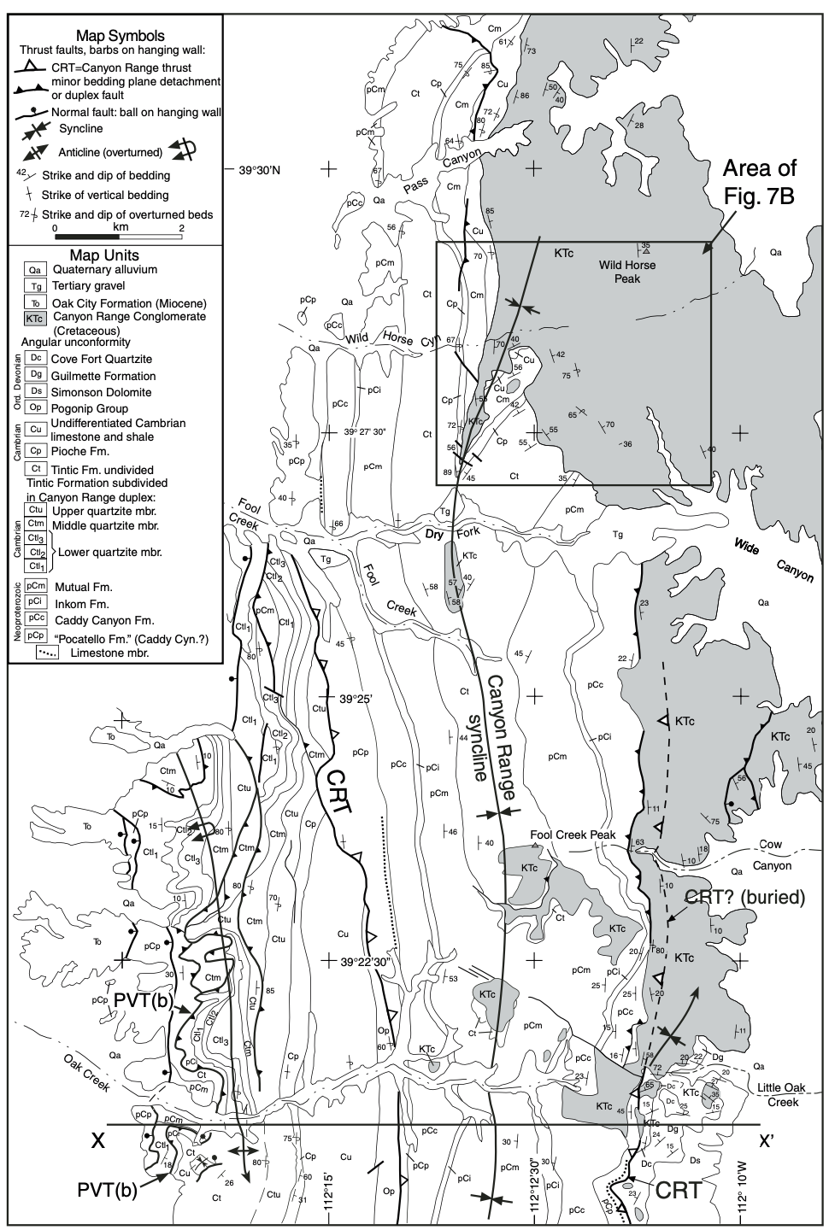
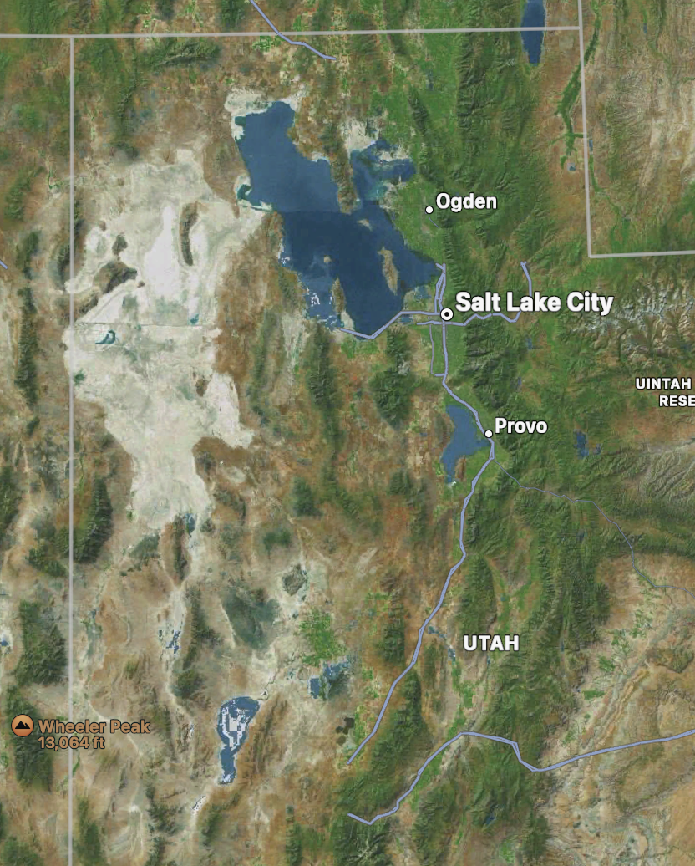
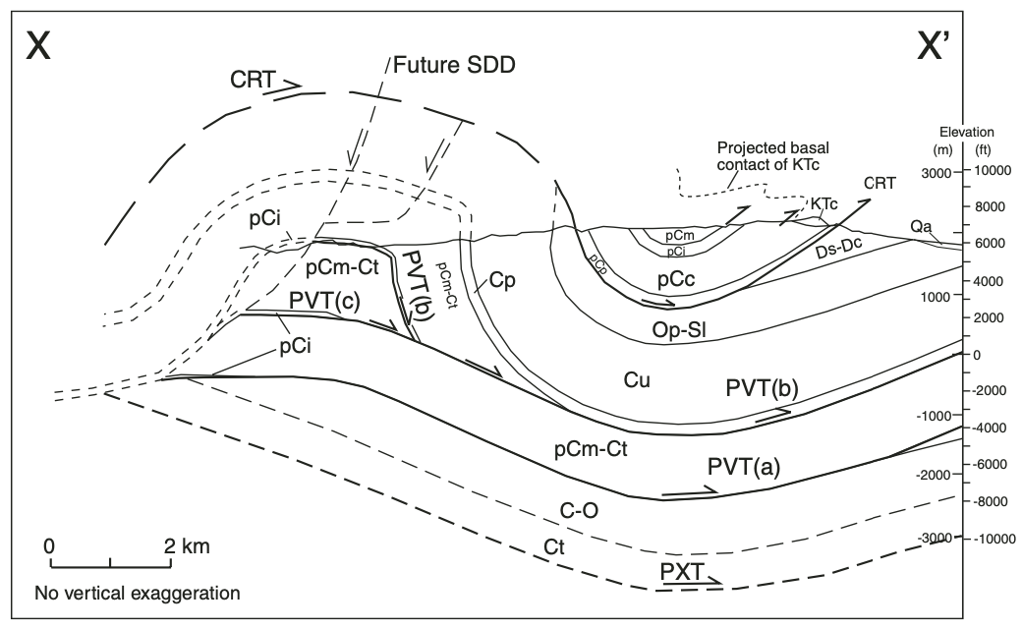
Structure
Exposed Canyon Range and Pavant thrusts reveal a syncline
Notes:
Significance: folding

Slide 6
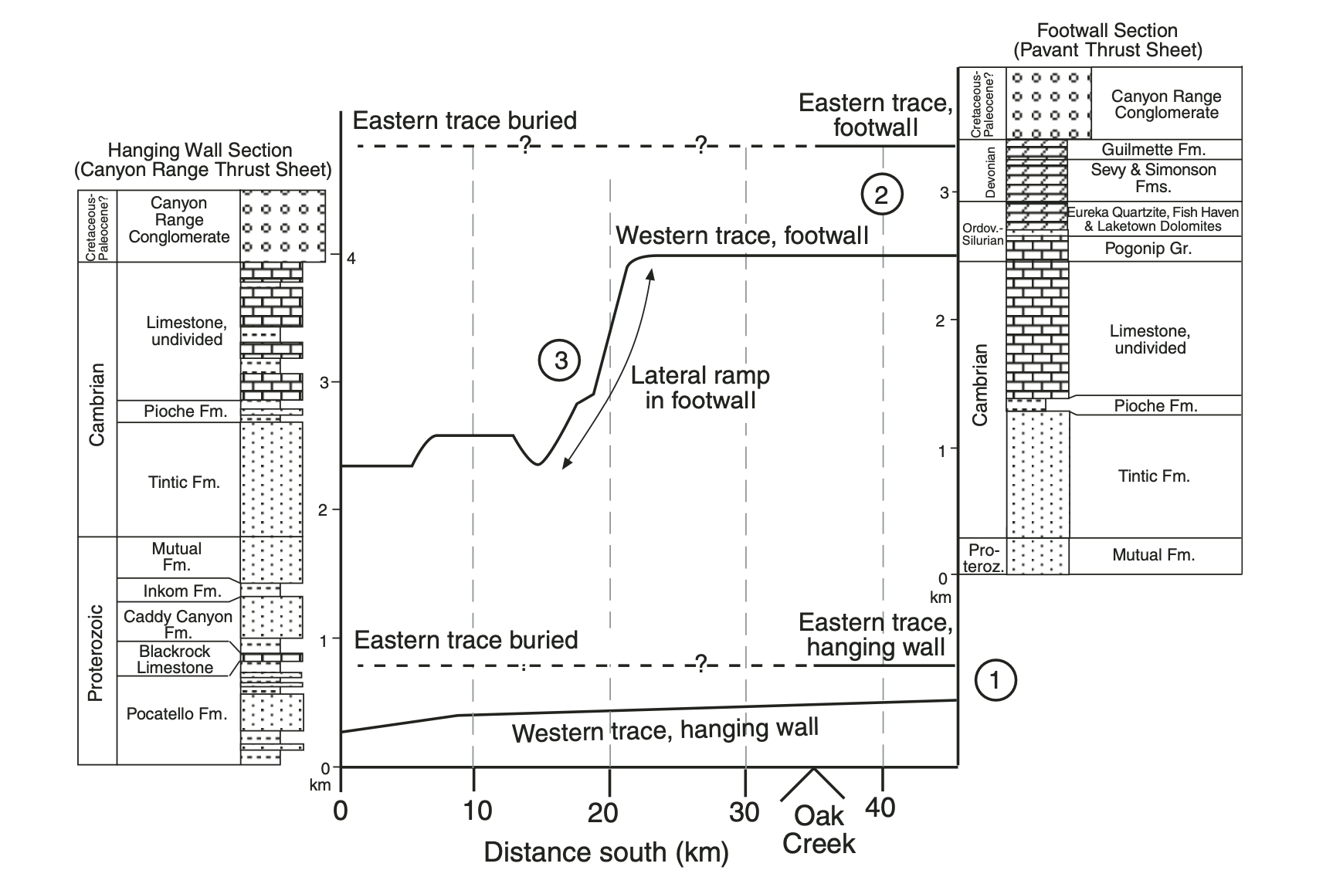
Structure
Notes:
1. Indicates low angle hanging wall ramp
2. Indicates relatively high angle thrust
3. Major northward dipping fault

Slide 7
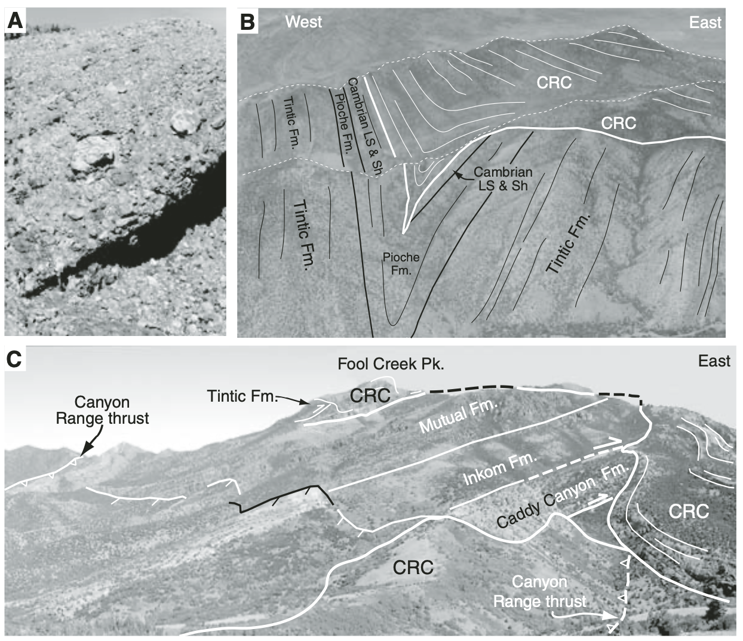
Structure
CRC: Canyon Range Conglomerate, only stratum that buries all thrust faults
Notes:
Syncline visible

Slide 8
Reconstruction
Age order:
Canyon Range Thrust (before 110 Ma)
Pavant Thrust (110-88 Ma)
Paxton Thrust (88-75 Ma)
Gunnison Thrust (75-66 Ma)
Notes:
Duplex: multiple faults in the same thrust belt?

Slide 9
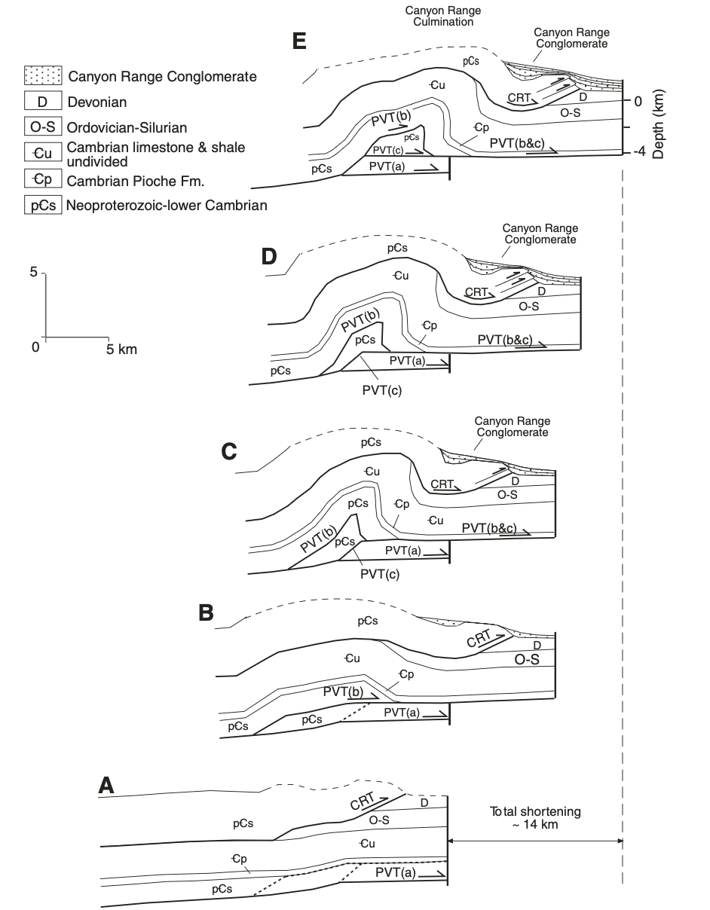
Reconstruction
14 km of compression at syncline revealed when reconstructed

Slide 10
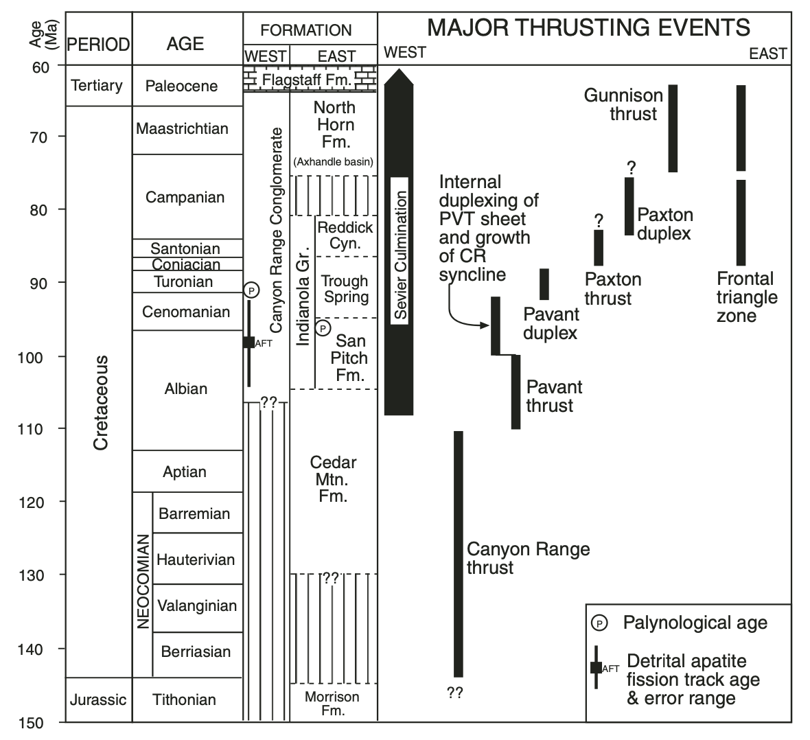
Age Model
Notes:
Culmination: folding of the syncline

Slide 11
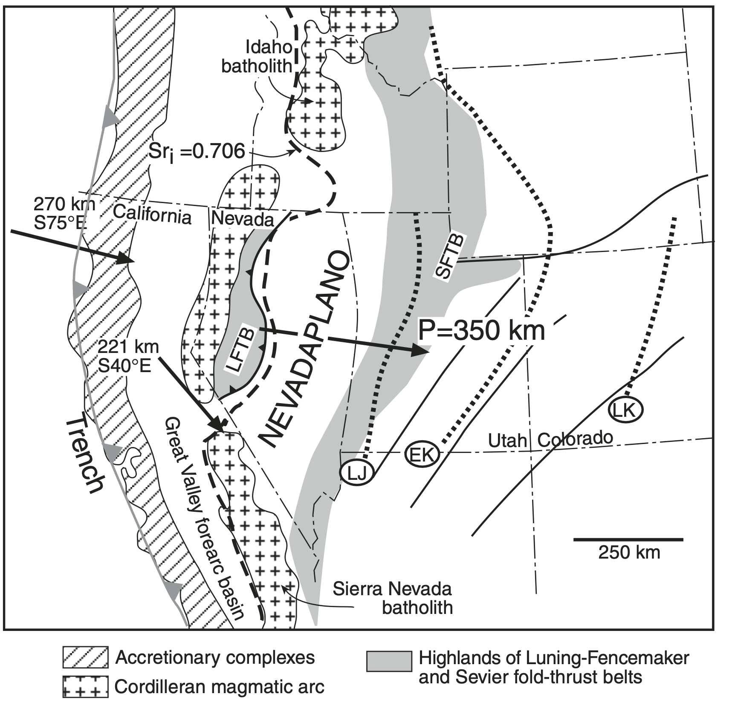
Regional Model
Sevier Thrust formed a 250 km wide plateau during Cretaceous
Thrust front moved 350 km east from Late Jurassic to Early Cretaceous

Slide 12
Summary
Starting in the Cretaceous: ~220 km of crustal compression accommodated by Sevier Thrust belts
Ample evidence from Central Utah regional structures
Thrust front migrated eastward

